Slide 1
Pitfall 4: Fighting Fake Contents
AI can be used to generate fake contents
Fake Image
Fake Audio
Fake Video
Fake News
Many are likely intended to be humorous, but some could be harmful to individuals and community.
An Arm Race between Fake Content Generator and Detection
AI against AI

Slide 2
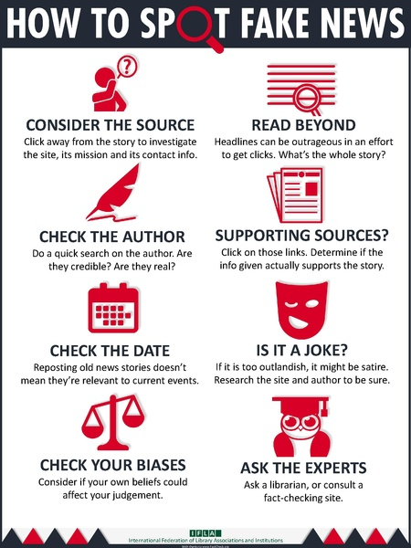
Defending Against Fake News
Fact-Checking
Against the truths we know
MOHD SANAD ZAKI RIZVI, An Exhaustive Guide to Detecting and Fighting Neural Fake News using NLP, 2019.

Slide 3
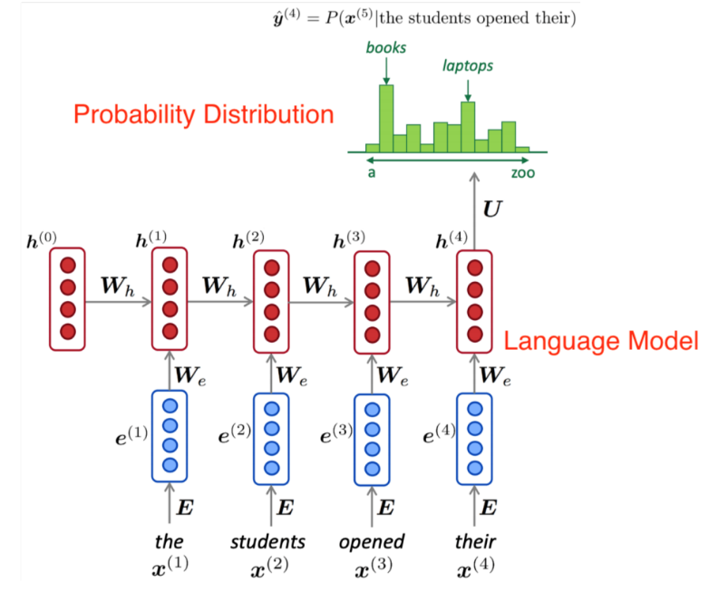
Defending Against Fake News
Statistical Analysis
Assumption
The words that a language model generates directly come from the probability distribution that it learned from the training data itself
Cross-check whether a word in a given text follows this distribution
MOHD SANAD ZAKI RIZVI, An Exhaustive Guide to Detecting and Fighting Neural Fake News using NLP, 2019.

Slide 4
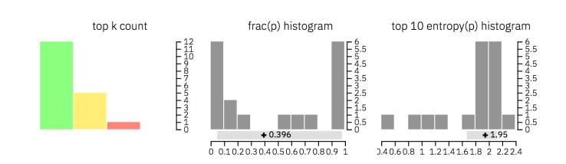
GLTR (Giant Language model Test Room)
How much wood would a woodchuck chuck if a woodchuck could chuck wood?
Input text
Prediction
Green: top-10, Yellow: top-100, Red: top-1000
Aggregation
High uncertainty: Model has low confidence of each prediction (real)
Low uncertainty: Model has high confidence of each prediction (fake)
https://www.analyticsvidhya.com/blog/2019/12/detect-fight-neural-fake-news-nlp/
Notes:
The first one shows how many words of each category (top 10, top 100 and top 1000) appear in the text
The second one illustrates the ratio between the probabilities of the top predicted word and the following word
The third histogram displays the distribution over the entropies of the predictions. A low uncertainty means that the model was very confident of each prediction, whereas a high uncertainty implies low confidence

Slide 5
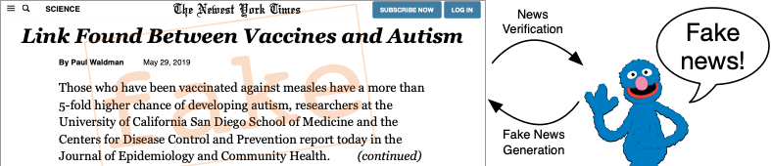
Defending Against Fake News
Use an AI model
Train an AI model to predict whether a piece of text is fake news or not
State-of-the-Art Models
GPT-2 Detector Model
Trained as a classification problem
Grover (AllenNLP)
Trained as an adversarial model
MOHD SANAD ZAKI RIZVI, An Exhaustive Guide to Detecting and Fighting Neural Fake News using NLP, 2019.

Slide 6
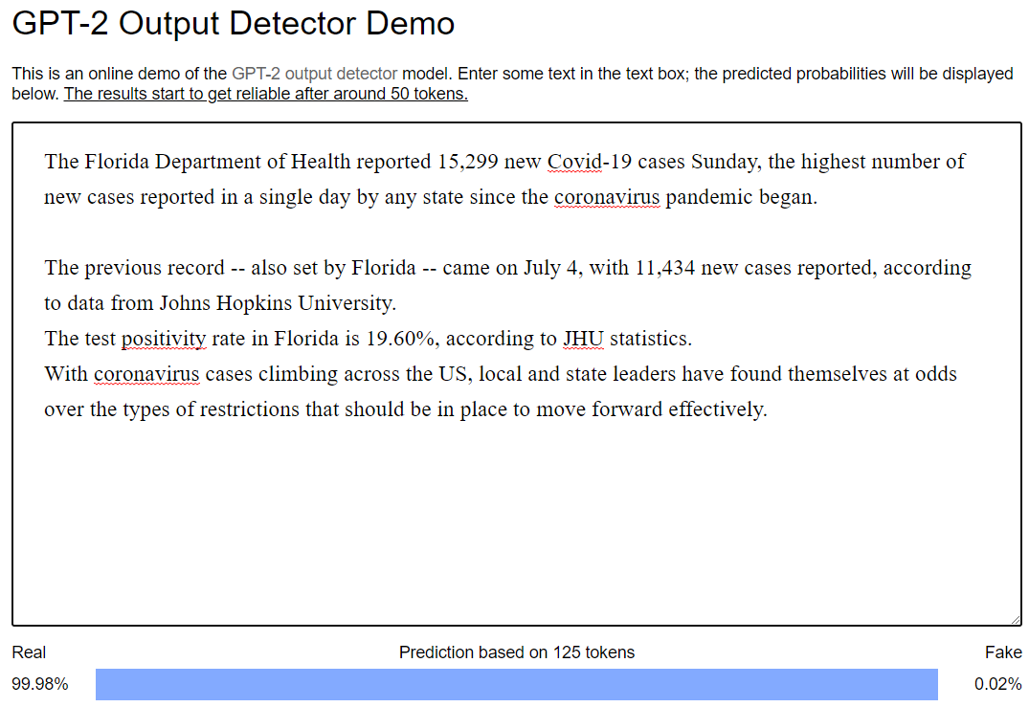
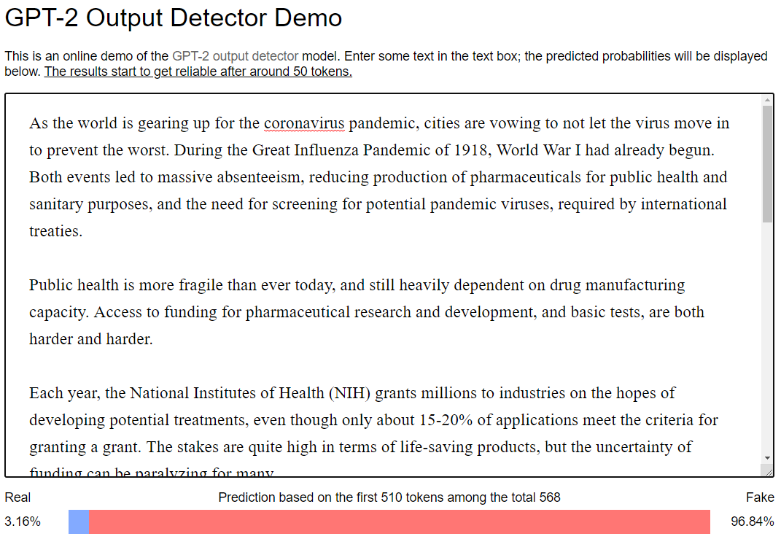
Demo: GPT-2 for Detecting Fake News
Run GPT-2 Detector
python -m detector.server detector-base.pt --port 8000
notrealnews.net

Slide 7
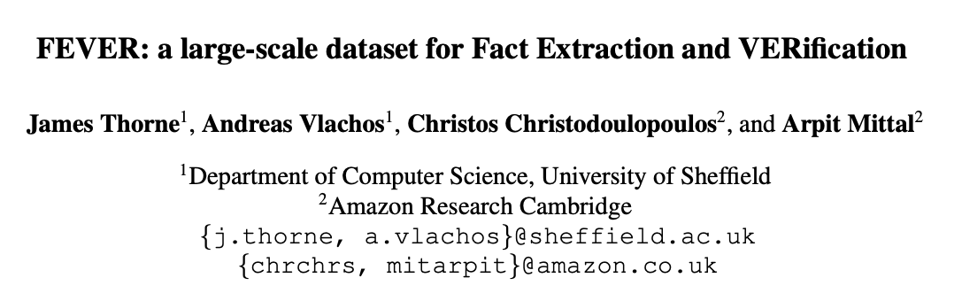
Limitations of Existing Fake News Detection Techniques
Just finding whether a piece of text is “machine-generated” or not is not enough
Machine Assistant Tools are popularly used
Auto-completion
Text summary
Grammarly
Attacker can slightly modify or corrupt human-written text
Future Research Directions
Building a fact-checking datasets
AI models for fact checking and validation

Slide 8


DeepFake
DeepFake: Replace a person in an existing image or video with someone else's likeness

Slide 9
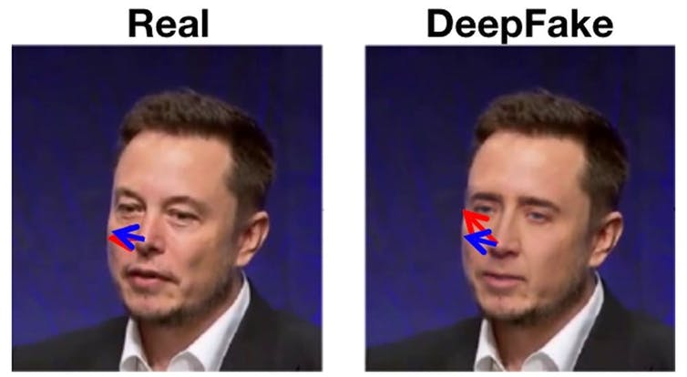
Defending Against DeepFake
Finding Flaws
Mismatches in particular frames
Inconsistent lighting conditions or distance to the camera
Severe transformation
Nicolas Cage’s face on Elon Musk’s head. The face does not line up with the head correctly.
Xin Yang, Yuezun Li, Siwei Lyu, Exposing Deep Fakes Using Inconsistent Head Poses, arXiv:1811.00661, 2018.

Slide 10
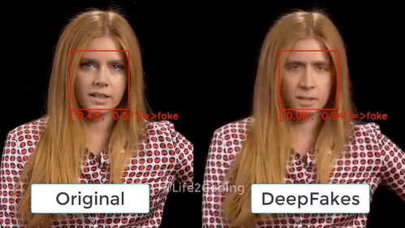
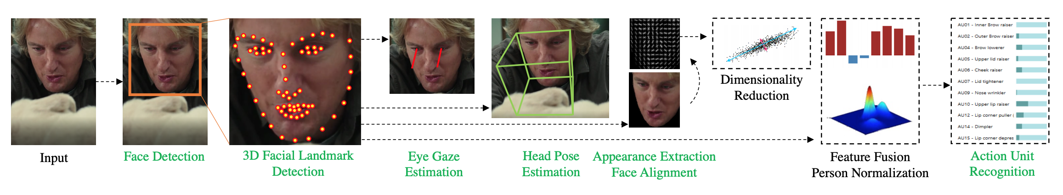
Defending Against DeepFake
Combining Object Identification and DeepFake Detection
Source: OpenFace 2.0: Facial Behavior Analysis Toolkit

Slide 11
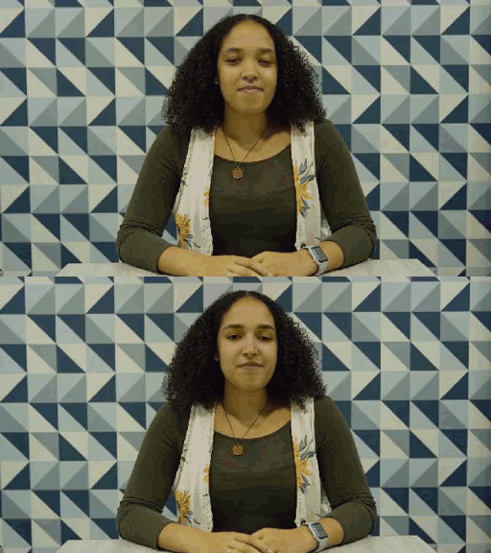
Contributing Data to DeepFake Detection Research
DeepFake Detection Research
An global effort against potential DeepFake abuse and harm
https://ai.googleblog.com/2019/09/contributing-data-to-deepfake-detection.html

Slide 12
Summary
Big Data and AI
Tremendous innovation in technology
Revolutionary breakthroughs in many applications
But, have potential risks and pitfalls at the same time
It is important to understand
How to best harness big data
How AI models work (and do not work)
The hidden risks behind big data and AI

